Slide 1
Data Visualization With Pandas
Overview
In this lesson, students will learn how to use the Pandas library to visualize data.
Duration 120 minutes
Learning Objectives
In this lesson, students will:
Explain the characteristics of a great data visualization.
Identify when to use a bar chart, pie chart, line chart, scatterplot, or histogram.
Use Pandas to implement line charts, bar charts, scatterplots, and histograms.

Slide 2
Pre-Class Materials and Preparation
For remote classrooms: Virtual breakout rooms and Slack may be needed to facilitate the partner exercise and discussions. As you plan for your lesson:
Consider how you’ll create pairs for the partner exercise (randomly, or with pre-assigned partners).
Determine how (if at all) exercise timing may need to be adjusted.
For helpful tips, keep an eye out for the For remote classrooms tag in the speaker notes.
Prepare screenshots and answers to exercises in advance so that they can be easily shared in Slack during your lecture.

Slide 3
Suggested Agenda
Time | Activity
0:00–0:20 | Welcome + Data Visualization Best Practices
0:20–1:00 | Using Pandas to Visualize Data
1:00–1:10 | Break
1:10–1:50 | Using Pandas to Visualize Data (Cont.)
1:50–2:00 | Wrapping Up, Q&A, and Exit Ticket Completion

Slide 4
Jupyter Notebook
The exercises referred to in this lesson can be found in the Python Workbooks + Data folder.

Slide 5
Data Visualization With Pandas
Notes:
Duration: 5 minutes

Slide 6
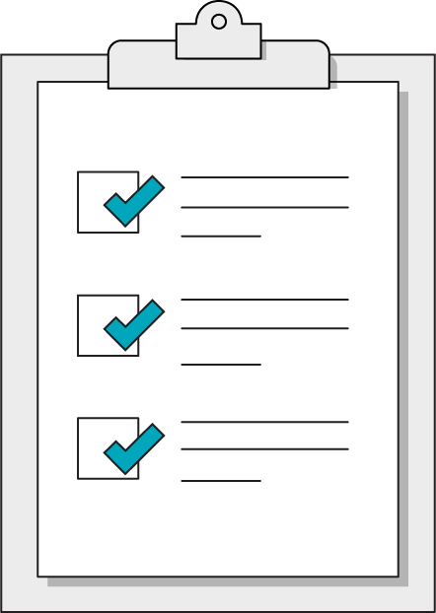
Our Learning Goals
Explain the characteristics of a great data visualization.
Identify when to use a bar chart, pie chart, line chart, scatterplot, or histogram.
Use Pandas to implement line charts, bar charts, scatterplots, and histograms.
Notes:
Purpose: Set expectations for the lesson.
For remote classrooms:
Capture a screenshot of this slide and drop it in the class Slack channel.

Slide 7
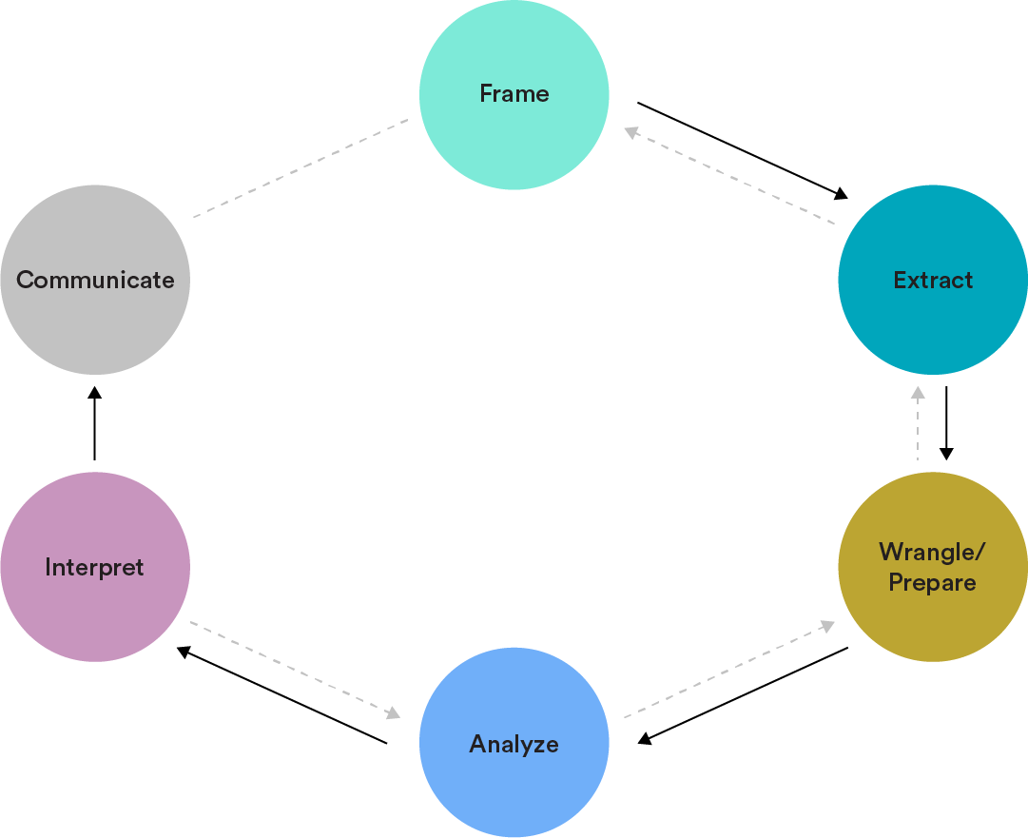
The Data Analytics Workflow
Interpret: Leverage your analysis to make decisions and recommendations.
Communicate: Present data-driven findings and insights in a compelling manner.
Notes:
Purpose: Set context for this lesson in terms of the Data Analytics Workflow.

Slide 8
Data Visualization Best Practices
Data Visualization With Pandas
Notes:
Duration: 15 minutes

Slide 9
Use a picture. It’s worth a thousand words.
— Tess Flanders, newspaper editor, 1911
Notes:
Purpose: Emphasize the importance of data visualization.

Slide 10
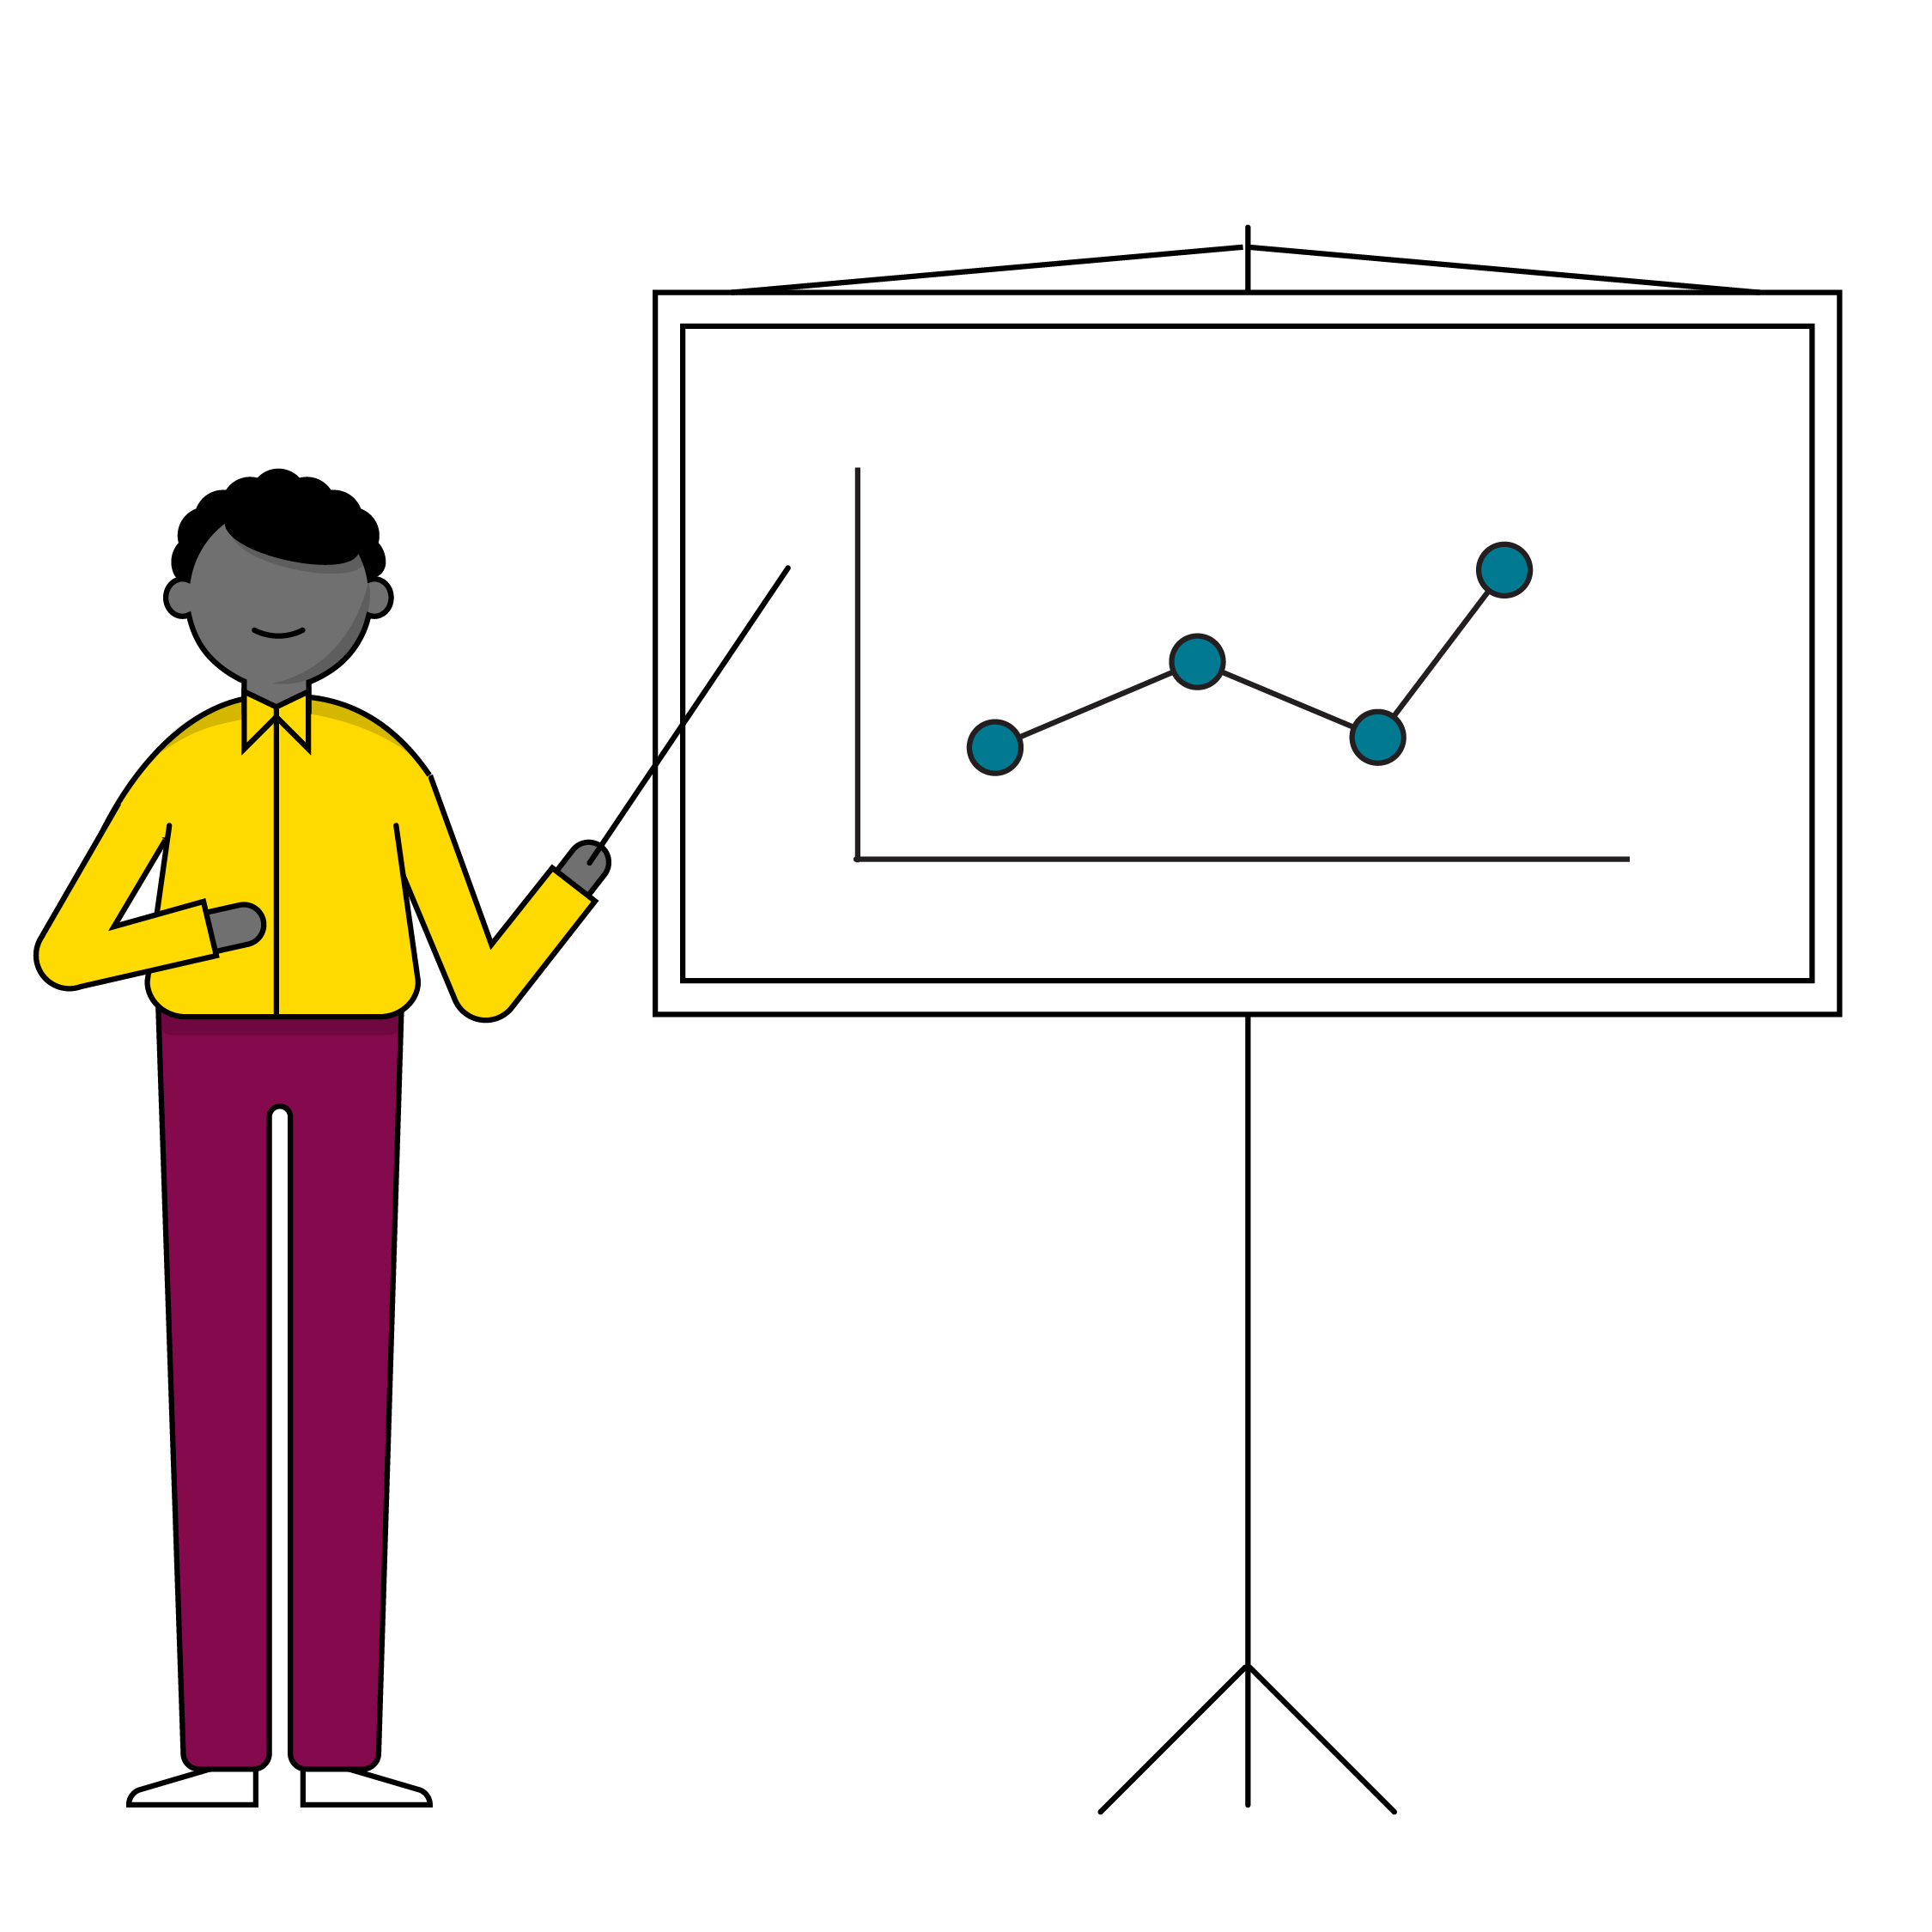
What Is Data Visualization?
Data visualizations are a quick way to convey insights from data sets. Specifically, we can use visuals to:
Identify outliers during exploratory data analysis.
Describe patterns or trends in the data.
Summarize the results of an analysis and communicate key insights.
Notes:
Purpose: Emphasize the importance of data visualization.
TALKING POINTS:
Because of the way the human brain processes information, charts or graphs that visualize large amounts of complex data are easier to understand than spreadsheets or reports.
Data visualization is a quick, easy way to convey concepts in a universal manner, and you can experiment with different scenarios by making slight adjustments.

Slide 11
Criteria for Good Visualizations
Simplified
Distill your insight to its essential components.
1
Easy to Interpret
Use logical ordering and understandable metrics.
2
Clearly Labeled
Use clearly distinguishable colors and avoid cluttering text.
3
Notes:
Purpose: Introduce what makes a good data visualization.

Slide 12

Choosing the Right Chart Type
With so many chart types, it can be difficult to know how best to display your data.
When creating a visualization, first think about the variables you are displaying, the volume of data you’re showcasing, and the central point you are hoping to communicate through your visualization.
Notes:
Purpose: Introduce how to select the appropriate chart for data.
TALKING POINTS:
Choosing the wrong type of chart for a given data point can result in audience confusion or even be downright misleading.
If you're unsure of which chart type to use, it may be that you don't have a clear enough point you're trying to make with said chart.

Slide 13
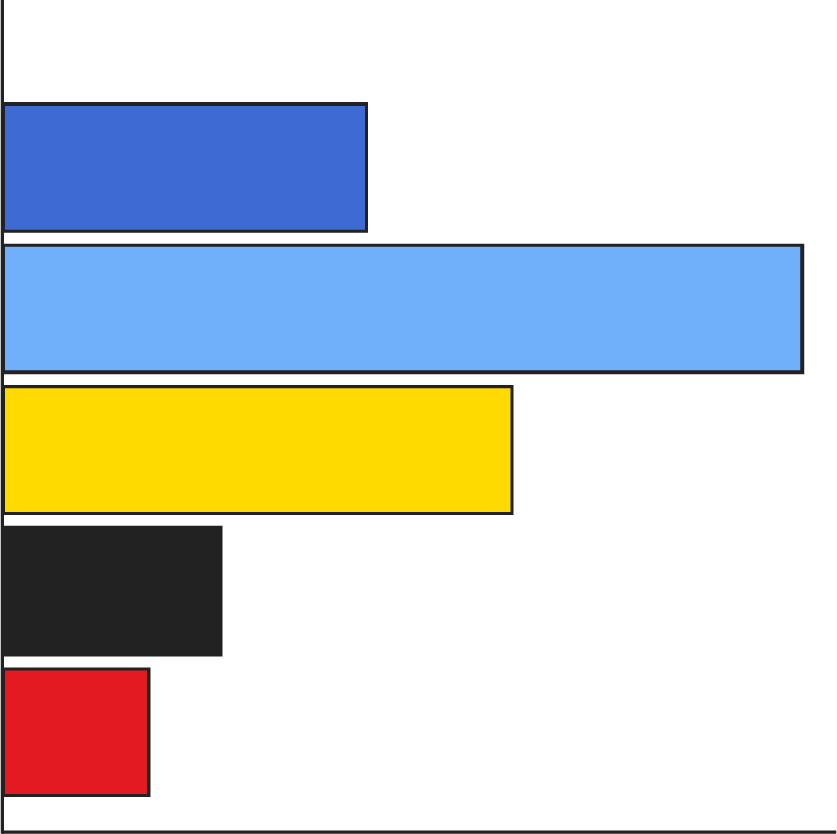
Bar Charts
Bar charts are one of the most common ways of visualizing data. Why? Because they make it easy to compare information among categories, revealing highs and lows quickly and efficiently.
Bar charts are most effective when you have categorical data and want to explore counts of different categories.
Notes:
Purpose: Introduce bar charts.
TALKING POINTS:
When thinking about using a bar chart, consider:
Will you use vertical or horizontal bars?
How will you number your axis (it is always best to start at zero)?
How will you order your bars?

Slide 14
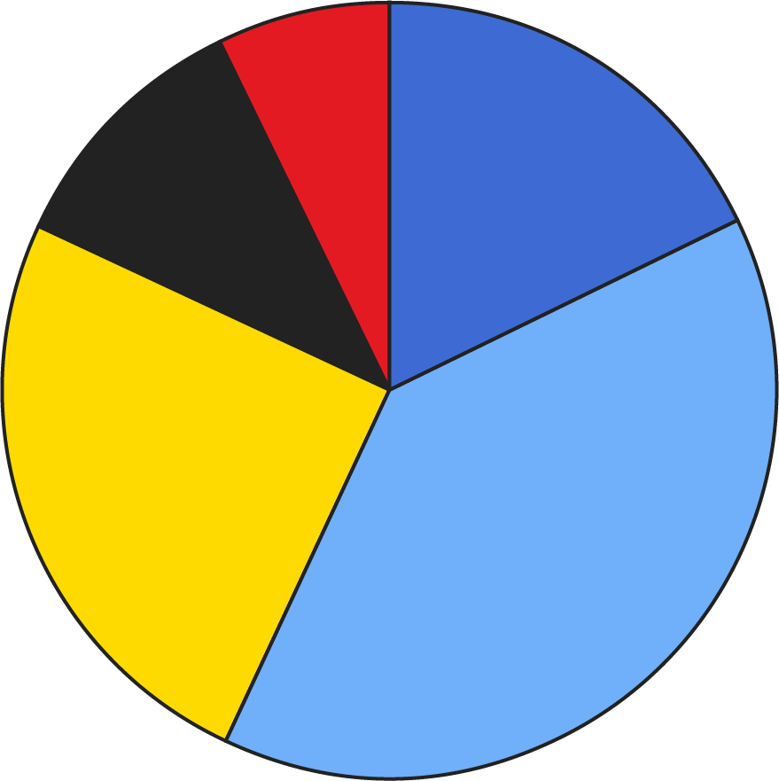
Pie Charts
Pie charts are the most commonly misused chart type. If there are more than 2–3 categories involved, they can often mislead readers. Pie charts should only be used to show relative proportions or percentages of information.
If you want to compare data, leave it to bars or stacked bars.
Notes:
Purpose: Introduce pie charts.
TALKING POINTS:
When thinking about using a pie chart, consider:
The more variables you have, as in the more slices of the pie you have, the more difficult your pie chart is to read.
Area is very difficult for the eye to read, so if any of your wedges are similar in size, consider using a different chart type.
If you want to compare data, leave it to bars or stacked bars.
If your viewer has to work hard to translate pie wedges into relevant data or compare pie charts to one another, the key points you're trying to convey might go unnoticed.

Slide 15
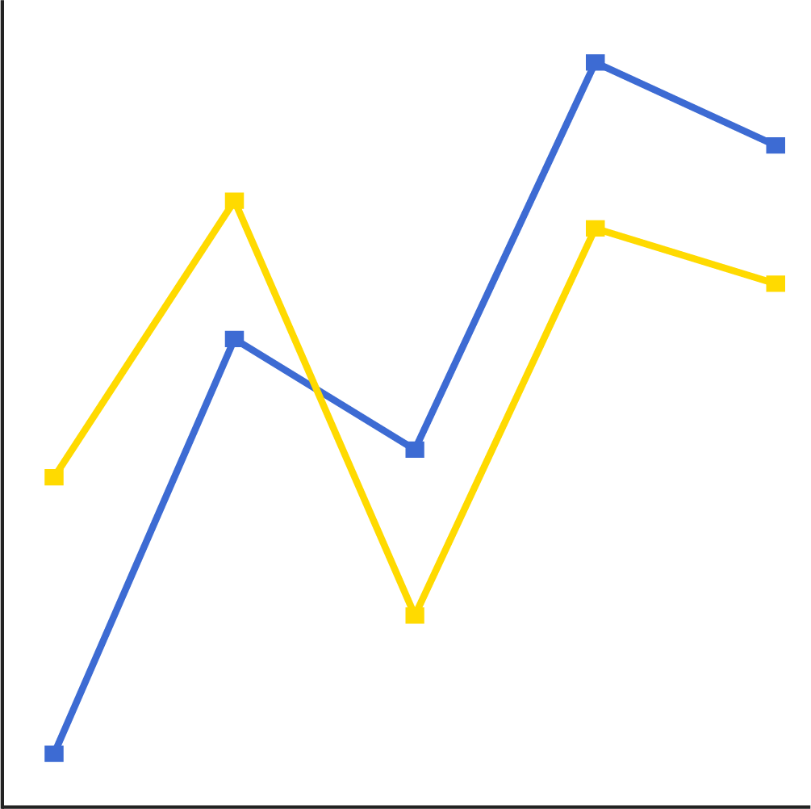
Line Charts
Line charts (or line graphs) are an excellent way to show change over time. They work best when you have one time variable and one set of data points to show.
While bar charts can also display time, they don’t show it in a continuous way.
Notes:
Purpose: Introduce line charts.

Slide 16
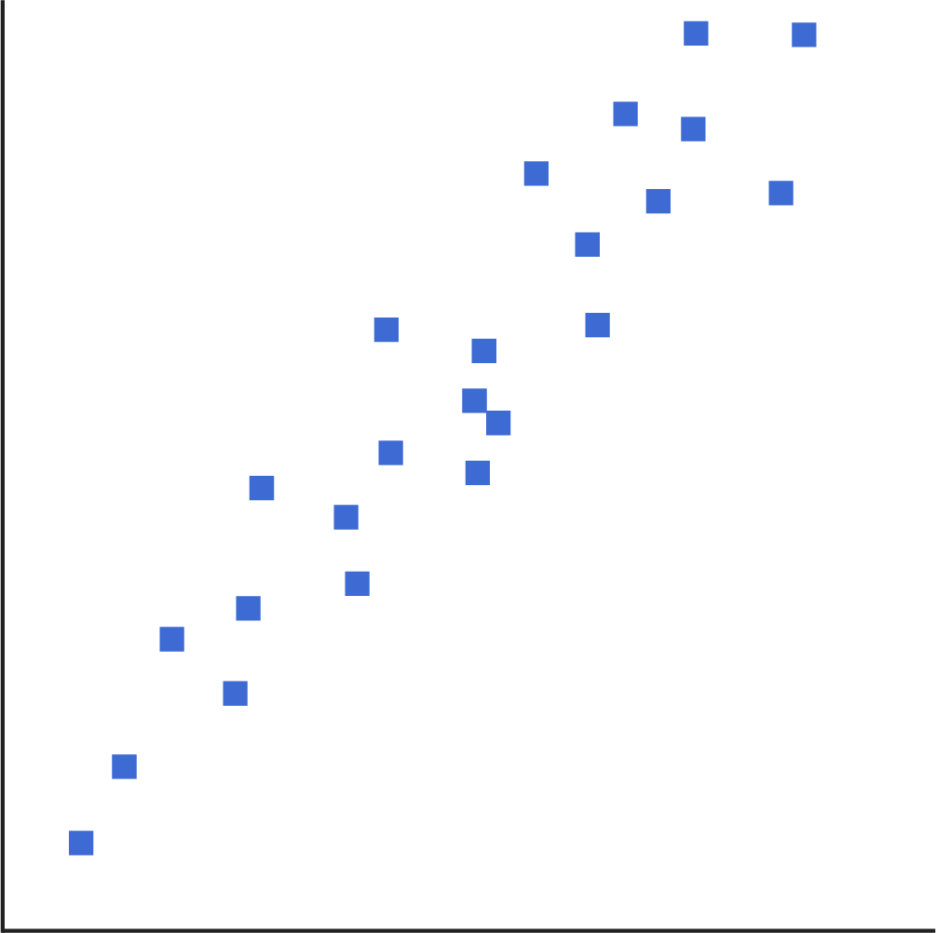
Scatterplots
Scatterplots are great for giving viewers a sense of trends, concentrations, and outliers. They’re also useful for illustrating correlations between two variables, depending on whether the shape is clearly concentrated or scattered far apart. This will provide a clear idea of what you may want to investigate further.
Notes:
Purpose: Introduce scatter plots.

Slide 17
Knowledge Check!
Which type of data visualization should we use for the scenario below?
Scenario: Change in average income since 1960 for American adults.
Answer: Line charts are ideal for expressing change over time.
Notes:
Purpose: Get students to consider which charts to use in a given scenario.

Slide 18
Knowledge Check!
Which type of data visualization should we use for the scenario below?
Scenario: Amount of sales per state.
Answer: Bar charts are best for comparing numbers.
Notes:
Purpose: Get students to consider which charts to use in a given scenario.

Slide 19
Knowledge Check!
Which type of data visualization should we use for the scenario below?
Scenario: Determine if there's a correlation between book length and sales.
Answer: Scatterplots can compare the relationship between two variables.
Notes:
Purpose: Get students to consider which charts to use in a given scenario.

Slide 20
Using Pandas to Visualize Data
Data Visualization With Pandas
Notes:
Duration: 80 minutes

Slide 21
Pandas ❤️ Matplotlib
Pandas DataFrame objects use another library, known as Matplotlib, behind the scenes.
This means you can use Matplotlib functions in combination with Pandas methods to alter plots after drawing them.
For example, you can use Matplotlib’s xlabel() and title() functions to label the plot’s x axis and title, respectively, after it is drawn.
Notes:
Purpose: Introduce Matplotlib.
TALKING POINTS:
When researching how to get something done with Pandas visualizations, you can look into Matplotlib's functionality as well.
You might find more specific customizations for your plots by looking in the Matplotlib documentation instead of the Pandas documentation (although Pandas’ is pretty thorough).

Slide 22
The Plot Thickens
As we explore different types of plots, notice:
Different types of plots are drawn very similarly — they even tend to share parameter names.
In Pandas, calling plot() on a DataFrame is different than calling it on a Series. Although the methods are both named “plot,” they may take different parameters.
Notes:
Purpose: Share considerations for using Pandas and Matplotlib to build charts.

Slide 23
Our First Chart
Once you’ve loaded data into a Pandas DataFrame, creating a chart is as simple as using the .plot() method.
import pandas as pd
import matplotlib.pyplot as plt
data_frame = pd.read_csv(file_address)
data_frame[‘column_name’].plot()
Notes:
Purpose: Introduce how to use .plot().
TALKING POINTS:
By default, the .plot() method will create a line chart. As we’ve seen previously, this won't always be appropriate.

Slide 24
Plot Parameters
You may want to alter certain aspects of the chart, such as:
The kind of plot you want (line, bar, scatter, etc.).
The style of the lines, including color and line consistency.
The size of the chart, or figsize.
… plus many other settings.
Customizations can be made using keyword parameters:
data_frame[‘column_name’].plot(style={‘col1’: ‘r’}, figsize=(16,9))
Notes:
Purpose: Introduce how to customize charts.

Slide 25
9.1 Line Charts in Pandas
10 minutes
Let's practice creating line charts in Section 9.1 of the workbook.
Notes:
Purpose: Give students practice creating line graphs.

Slide 26
Counting Games per Country
If we alter our chart from using the “year” column to using the “country” column, all of a sudden the line chart stops making sense.
What chart should be used instead to compare the amount of games per country?
Notes:
Purpose: Connect working with .plot() to choosing the right type of chart.
TALKING POINTS:
The answer is a bar chart, as our intention is to compare numbers in a single column according to distinct categories.

Slide 27
9.2 Bar Charts
15 minutes
Let’s use the same data set to start creating bar charts in Section 9.2.
Notes:
Purpose: Give students practice creating bar charts.

Slide 28
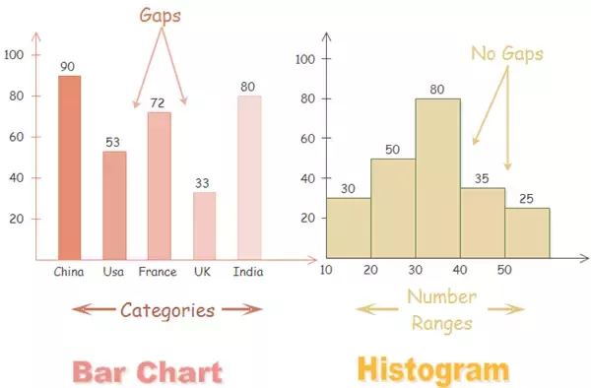
Bar Charts vs. Histograms
Another common chart style is a histogram, which plots the distribution of values according to numerically defined groups rather than distinct categories.
Source: Edrawsoft
Notes:
Purpose: Compare bar chart and histograms.
TALKING POINTS:
Histograms are useful when you want to see how your data is distributed across groups. Note that histograms are not the same as bar charts!
Histograms look similar to bar charts, but, with bar charts, each column represents a group defined by a categorical variable. With histograms, on the other hand, each column represents a group defined by a continuous, quantitative variable.
One implication of this distinction is that, with a histogram, it can be appropriate to talk about the the tendency of the observations to fall more on the low end or the high end of the x axis.
With bar charts, however, the x axis does not have a low end or a high end. This is because the labels on the x axis are categorical not quantitative

Slide 29
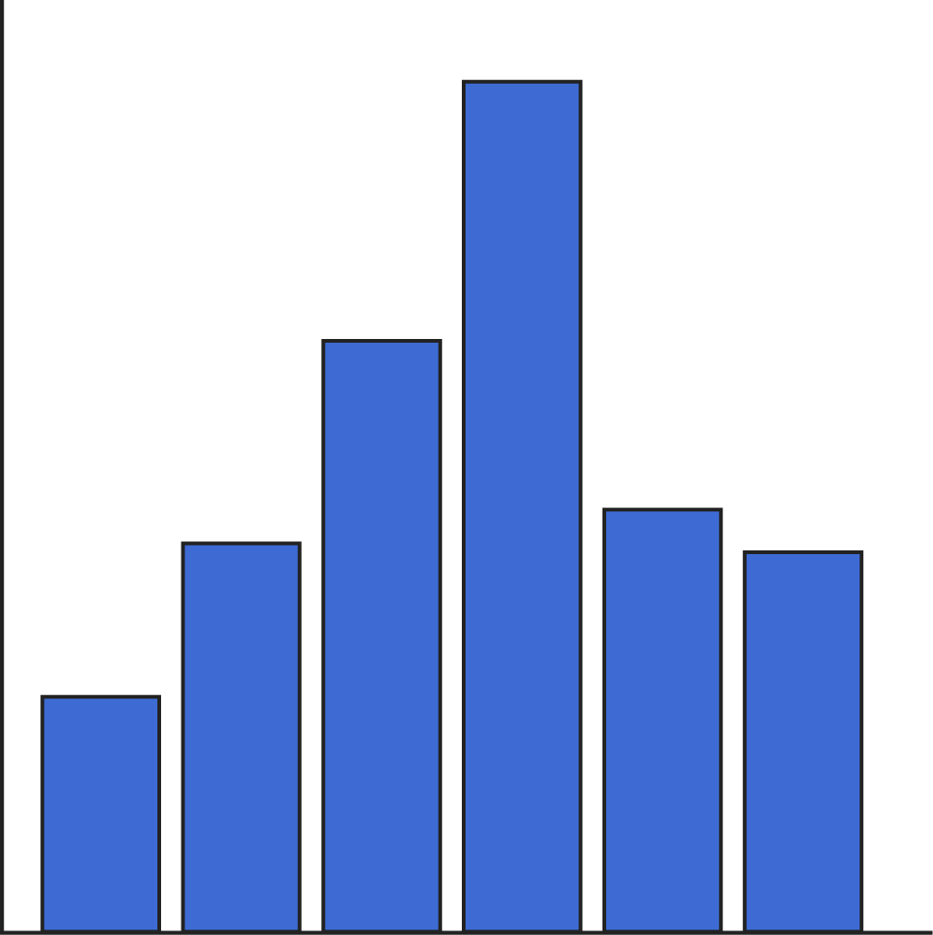
9.3 Histograms
10 minutes
Let’s look at some of the challenges of histograms in Section 9.3.
Notes:
Purpose: Give students practice working with histograms.

Slide 30
Scatterplots
Scatterplots intend to demonstrate the correlation, or lack thereof, between different variables. Therefore, we have to specify which columns to compare:
data_frame.plot(kind=‘scatter’, x=‘column_a’, y=‘column_b’)
Scatterplots are most useful when values are continuous, rather than discrete with large gaps.
Notes:
Purpose: Introduce how to create scatterplots.
TALKING POINTS:
When used with discrete values, scatterplots will have large, hard-to-interpret clumps around those discrete values, making trend lines more difficult to picture.

Slide 31
9.4 Scatterplots
10 minutes
Let's practice using scatterplots to investigate correlations in Section 9.4.
Notes:
Purpose: Give students practice working with scatterplots.

Slide 32
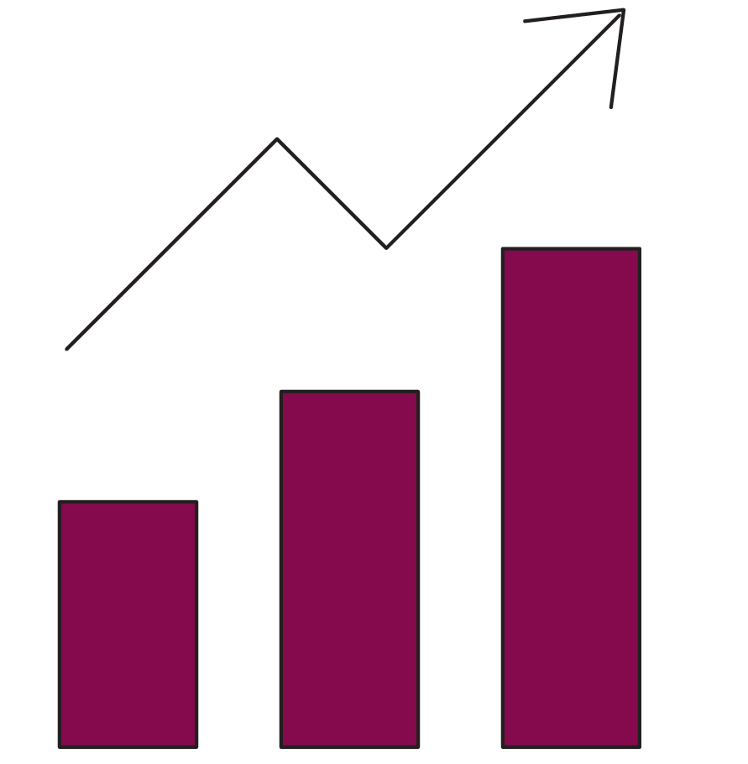
9.5 Visual Storytelling With Data
25 minutes
Working with the Superstore data set, use exploratory data analysis methods and at least one data visualization to communicate trends, outliers, and a hypothesis surrounding the data.
Notes:
Purpose: Give students practice bringing data visualization and EDA together.

Slide 33
Wrapping Up
Data Visualization With Pandas
Notes:
Duration: 10 minutes

Slide 34
Recap
Looking Ahead
In today’s class, we…
Explained the characteristics of a great data visualization.
Identified when to use a bar chart, pie chart, line chart, scatterplot, or histogram.
Used Pandas to implement line charts, bar charts, scatterplots, and histograms.
On your own:
Work through the Python progress assessment on myGA (due at the end of the unit).
Share your capstone project ideas with your instructor for review.
Join someone else’s project or invite others to join yours!
Next Class:
Cleaning and Combining Data With Pandas
Notes:
Purpose: Recap what was covered in the lesson.

Slide 35

Don’t Forget: Exit Tickets!

